Slide 1
Chapter 1 Introduction to Computers, Programs, and Java

Slide 2
Programs
Computer programs, known as software, are instructions to the computer.
You tell a computer what to do through programs. Without programs, a computer is an empty machine. Computers do not understand human languages, so you need to use computer languages to communicate with them.
Programs are written using programming languages.

Slide 3
Programming Languages
Machine Language Assembly Language High-Level Language
Machine language is a set of primitive instructions built into every computer. The instructions are in the form of binary code, so you have to enter binary codes for various instructions. Program with native machine language is a tedious process. Moreover the programs are highly difficult to read and modify. For example, to add two numbers, you might write an instruction in binary like this:
  1101101010011010

Slide 4
Programming Languages
Machine Language Assembly Language High-Level Language
The high-level languages are English-like and easy to learn and program. For example, the following is a high-level language statement that computes the area of a circle with radius 5:
area = 5 * 5 * 3.1415;

Slide 5

Interpreting Source Code
An interpreter reads one statement from the source code, translates it to the machine code or virtual machine code, and then executes it right away, as shown in the following figure. Note that a statement from the source code may be translated into several machine instructions.

Slide 6
Why Java?
The answer is that Java enables users to develop and deploy applications on the Internet for servers, desktop computers, and small hand-held devices. The future of computing is being profoundly influenced by the Internet, and Java promises to remain a big part of that future. Java is the Internet programming language.
Java is a general purpose programming language.
Java is the Internet programming language.

Slide 7
Java, Web, and Beyond
Java can be used to develop standalone applications.
Java can be used to develop applications running from a browser.
Java can also be used to develop applications for hand-held devices.
Java can be used to develop applications for Web servers.

Slide 8
Java’s History
James Gosling and Sun Microsystems
Oak
Java, May 20, 1995, Sun World
HotJava
  The first Java-enabled Web browser
Early History Website:
http://www.java.com/en/javahistory/index.jsp

Slide 9
Characteristics of Java
Companion Website
Java Is Simple
Java Is Object-Oriented
Java Is Distributed
Java Is Interpreted
Java Is Robust
Java Is Secure
Java Is Architecture-Neutral
Java Is Portable
Java's Performance
Java Is Multithreaded
Java Is Dynamic
www.cs.armstrong.edu/liang/JavaCharacteristics.pdf

Slide 10
Characteristics of Java
Companion Website
Java Is Simple
Java Is Object-Oriented
Java Is Distributed
Java Is Interpreted
Java Is Robust
Java Is Secure
Java Is Architecture-Neutral
Java Is Portable
Java's Performance
Java Is Multithreaded
Java Is Dynamic
Java is partially modeled on C++, but greatly simplified and improved. Some people refer to Java as "C++--" because it is like C++ but with more functionality and fewer negative aspects.

Slide 11
Characteristics of Java
Companion Website
Java Is Simple
Java Is Object-Oriented
Java Is Distributed
Java Is Interpreted
Java Is Robust
Java Is Secure
Java Is Architecture-Neutral
Java Is Portable
Java's Performance
Java Is Multithreaded
Java Is Dynamic
Java is inherently object-oriented. Although many object-oriented languages began strictly as procedural languages, Java was designed from the start to be object-oriented. Object-oriented programming (OOP) is a popular programming approach that is replacing traditional procedural programming techniques.
One of the central issues in software development is how to reuse code. Object-oriented programming provides great flexibility, modularity, clarity, and reusability through encapsulation, inheritance, and polymorphism.

Slide 12
Characteristics of Java
Companion Website
Java Is Simple
Java Is Object-Oriented
Java Is Distributed
Java Is Interpreted
Java Is Robust
Java Is Secure
Java Is Architecture-Neutral
Java Is Portable
Java's Performance
Java Is Multithreaded
Java Is Dynamic
Distributed computing involves several computers working together on a network. Java is designed to make distributed computing easy. Since networking capability is inherently integrated into Java, writing network programs is like sending and receiving data to and from a file.

Slide 13
Characteristics of Java
Companion Website
Java Is Simple
Java Is Object-Oriented
Java Is Distributed
Java Is Interpreted
Java Is Robust
Java Is Secure
Java Is Architecture-Neutral
Java Is Portable
Java's Performance
Java Is Multithreaded
Java Is Dynamic
You need an interpreter to run Java programs. The programs are compiled into the Java Virtual Machine code called bytecode. The bytecode is machine-independent and can run on any machine that has a Java interpreter, which is part of the Java Virtual Machine (JVM).

Slide 14
Characteristics of Java
Companion Website
Java Is Simple
Java Is Object-Oriented
Java Is Distributed
Java Is Interpreted
Java Is Robust
Java Is Secure
Java Is Architecture-Neutral
Java Is Portable
Java's Performance
Java Is Multithreaded
Java Is Dynamic
Java compilers can detect many problems that would first show up at execution time in other languages.
Java has eliminated certain types of error-prone programming constructs found in other languages.
Java has a runtime exception-handling feature to provide programming support for robustness.

Slide 15
Characteristics of Java
Companion Website
Java Is Simple
Java Is Object-Oriented
Java Is Distributed
Java Is Interpreted
Java Is Robust
Java Is Secure
Java Is Architecture-Neutral
Java Is Portable
Java's Performance
Java Is Multithreaded
Java Is Dynamic
Java implements several security mechanisms to protect your system against harm caused by stray programs.

Slide 16
Characteristics of Java
Companion Website
Java Is Simple
Java Is Object-Oriented
Java Is Distributed
Java Is Interpreted
Java Is Robust
Java Is Secure
Java Is Architecture-Neutral
Java Is Portable
Java's Performance
Java Is Multithreaded
Java Is Dynamic
Write once, run anywhere
With a Java Virtual Machine (JVM), you can write one program that will run on any platform.

Slide 17
Characteristics of Java
Companion Website
Java Is Simple
Java Is Object-Oriented
Java Is Distributed
Java Is Interpreted
Java Is Robust
Java Is Secure
Java Is Architecture-Neutral
Java Is Portable
Java's Performance
Java Is Multithreaded
Java Is Dynamic
Because Java is architecture neutral, Java programs are portable. They can be run on any platform without being recompiled.

Slide 18
Characteristics of Java
Companion Website
Java Is Simple
Java Is Object-Oriented
Java Is Distributed
Java Is Interpreted
Java Is Robust
Java Is Secure
Java Is Architecture-Neutral
Java Is Portable
Java's Performance
Java Is Multithreaded
Java Is Dynamic
Java’s performance Because Java is architecture neutral, Java programs are portable. They can be run on any platform without being recompiled.

Slide 19
Characteristics of Java
Companion Website
Java Is Simple
Java Is Object-Oriented
Java Is Distributed
Java Is Interpreted
Java Is Robust
Java Is Secure
Java Is Architecture-Neutral
Java Is Portable
Java's Performance
Java Is Multithreaded
Java Is Dynamic
Multithread programming is smoothly integrated in Java, whereas in other languages you have to call procedures specific to the operating system to enable multithreading.

Slide 20
Characteristics of Java
Companion Website
Java Is Simple
Java Is Object-Oriented
Java Is Distributed
Java Is Interpreted
Java Is Robust
Java Is Secure
Java Is Architecture-Neutral
Java Is Portable
Java's Performance
Java Is Multithreaded
Java Is Dynamic
Java was designed to adapt to an evolving environment. New code can be loaded on the fly without recompilation. There is no need for developers to create, and for users to install, major new software versions. New features can be incorporated transparently as needed.

Slide 21
JDK Versions
JDK 1.02 (1995)
JDK 1.1 (1996)
JDK 1.2 (1998)
JDK 1.3 (2000)
JDK 1.4 (2002)
JDK 1.5 (2004) a. k. a. JDK 5 or Java 5
JDK 1.6 (2006) a. k. a. JDK 6 or Java 6
JDK 1.7 (2011) a. k. a. JDK 7 or Java 7
JDK 1.8 (2014) a. k. a. JDK 8 or Java 8

Slide 22
JDK Editions
Java Standard Edition (J2SE)
  J2SE can be used to develop client-side standalone applications or applets.
Java Enterprise Edition (J2EE)
  J2EE can be used to develop server-side applications such as Java servlets, Java ServerPages, and Java ServerFaces.
Java Micro Edition (J2ME).
  J2ME can be used to develop applications for mobile devices such as cell phones.
This book uses J2SE to introduce Java programming.

Slide 23
Popular Java IDEs
NetBeans
Eclipse

Slide 24
A Simple Java Program
Listing 1.1
// This program prints Welcome to Java!
public class Welcome {
public static void main(String[] args) {
System.out.println("Welcome to Java!");
}
}
Note: Clicking the green button displays the source code with interactive animation. You can also run the code in a browser. Internet connection is needed for this button.
Welcome
Run
Note: Clicking the blue button runs the code from Windows. If you cannot run the buttons, see www.cs.armstrong.edu/liang/javaslidenote.doc.

Slide 25
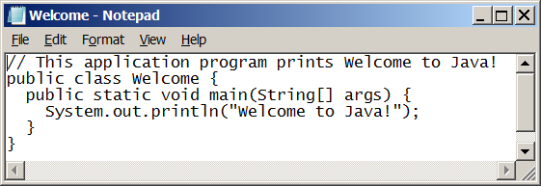
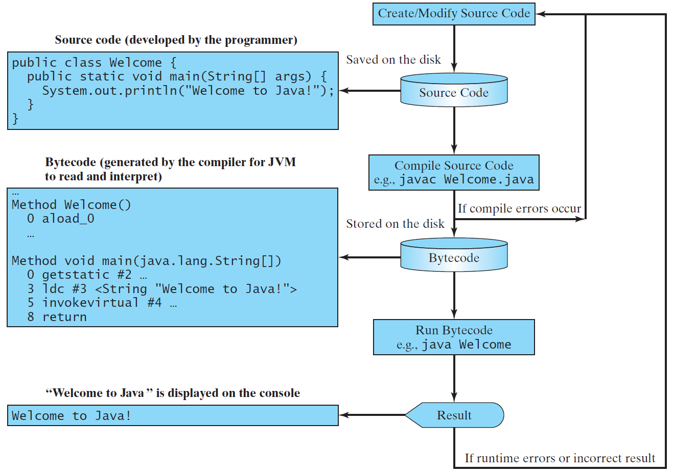
Creating, Compiling, and Running Programs

Slide 26
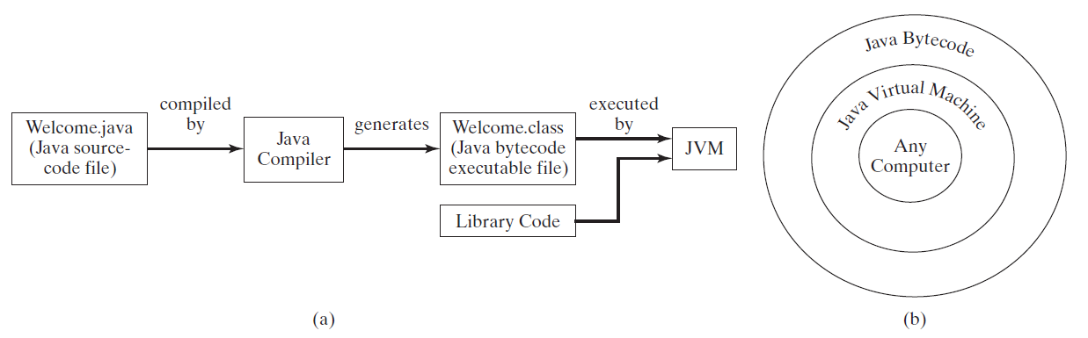
Compiling Java Source Code
You can port a source program to any machine with appropriate compilers. The source program must be recompiled, however, because the object program can only run on a specific machine. Nowadays computers are networked to work together. Java was designed to run object programs on any platform. With Java, you write the program once, and compile the source program into a special type of object code, known as bytecode. The bytecode can then run on any computer with a Java Virtual Machine, as shown below. Java Virtual Machine is a software that interprets Java bytecode.

